Slide 1
Molecular Evolution of Rotavirus
Qiancheng Xiong
Supervisors:
Dr Simon Frost | Dr Bethany Dearlove

Slide 2
1.1 Introduction - Rotavirus
Rotavirus (RV) is a major cause of acute gastroenteritis (traveller’s diarrhoea)^{1,2}.
RV still causes around 500,000 deaths annually among young children³.
RV also results in economic loss through hospitalizations of workforce, and deaths of animals^{4,5}.

Slide 3
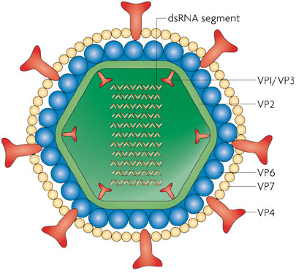
1.1 Introduction - Rotavirus
Transcription complex
Double-stranded RNA (dsRNA) virus
11 segments encoding for
6 structural viral proteins (VPs: VP1-VP4, VP6 and VP7)
6 nonstructural proteins (NSPs: NSP1-NSP6)

Slide 4
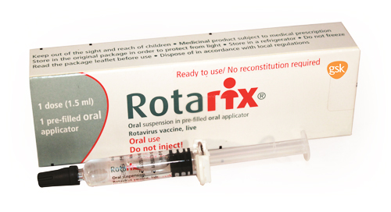
1.1 Introduction - Rotavirus
8 different species, RVA to RVH¹
RVA is the most prevalent²
Other widely studied species include RVB (Asia) and RVC.
Moderns vaccines available for RVA
Rotarix® (GlaxoSmithKline)
RotaTeq® (Merck)
Based on exterior VP4 and VP7
Image: GlaxoSmithKline. Rotarix Product Pack. Digital image. Rotarix (oral Live Rotavirus Vaccine) - GSK Pharma UK Public Site. Web. 08 Mar. 2015.

Slide 5
1.2 Introduction - Purpose of Study
Compare the evolutionary patterns
Between species
Between proteins
Between hosts
Before and after the widespread use of modern* vaccines in 2005
*An earlier vaccine, RotaShield ®, was discontinued due to fatal side effects.

Slide 6
2.1 Methods - Workflow
Download sequences from GenBank
Reorganise sequences and metadata
Multiple Sequence Alignment (MSA) and sequence clean-up
Recombination checks
Analysis
Selection
Mutation rates
Effective population size

Slide 7
2.2 Methods - Selection Analyses
Selection pressures can be captured by estimating nonsynonymous (b) and synonymous substitution rates (a)
A Fast Unconstrained Bayesian Approximation (FUBAR) was used to estimate these rates on:
Gene level
Site by site level
The algorithm fits a grid of values of b and a to each site in an alignment, and can scale to thousands of sequences

Slide 8
3.1 Results - Selection

Slide 9
3.1 Results - Selection
Between species
RVA has a much higher dN/dS value on VP7, a potential cause for the huge variety of P genotypes based on VP7.
RVA also has a much higher dN/dS value on NSP4 (enterotoxin)
RVB has higher dN/dS values on VPs than other RVs, as well as a much higher value on NSP3 (host translation shutoff).

Slide 10
3.1 Results - Selection
VPs vs NSPs
Overall, structural VPs has lower dN/dS value than NSPs
Structural proteins less tolerable to change?
NSP
NSP2 has the lowest dN/dS values across all species (NTPase/helicase)
NSP4 has very high dN/dS values across all species (enterotoxin)
VP
VP4 has high dN/dS values probably due its outer most exterior position and interactions with host cells
Low dN/dS values for VP6 across all species make the protein a good vaccine target
Negatively selected sites may be suitable targets for vaccines because changes at these sites are likely to be intolerable¹

Slide 11
3.1 Results - Selection
Host effects
No obvious difference across proteins in RVC
Slightly higher positive selection in RVB in human hosts

Slide 12
3.1 Results - Selection
Vaccine: 10 years before and after introduction

Slide 13
3.1 Results - Selection
Well adapted virus: lots of negative selection¹
Selection across whole VP4 sequence did not change much after vaccine introduction
2 new sites under positive selection; 1 under strong negative selection
Codon 2: Ala (gct) to Val (gtt)
Codon 161: STOP (tag) to a variety of other amino acids, allowing a read through
Codon 311: artefact due to gaps in majority of sequences at this codon

Slide 14
Evolution rates
Sequences were annotated by time of sampling (or within a range)
This was used to estimate the evolutionary rate over time using the program Bayesian Evolutionary Analysis Sampling Trees (BEAST)

Slide 15
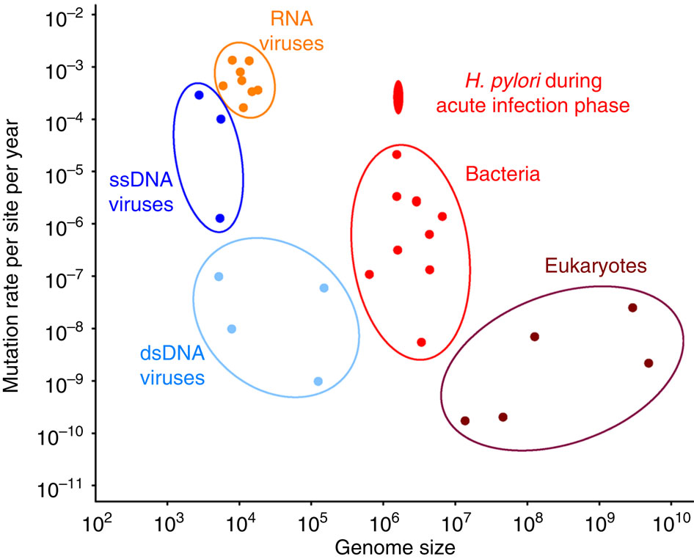
3.2 Results - Mutation Rates

Slide 16
Red – RVA | Green – RVB | Blue – RVC | Bars – 95% HPD

Slide 17
3.2 Results - Mutation Rates
Between species
In general, RVB has higher mutation rates than RVA and RVC, especially in NSP1 and NSP4 (agree with high estimates of b/a)
Not much difference between RVA and RVC, except for NSP4 where RVC has a significantly higher substitution rate
Possible reason for RVB’s higher mutation rates
NSP1: suppress host INF response
NSP4: enterotoxin
High mutation rates aid colonization of new hosts?

Slide 18
3.2 Results - Mutation Rates
Between proteins
Within RVA: NSP1>NSP3>NSP4>NSP5>NSP2
Within RVB: NSP1, NSP4>NSP5>NSP3>NSP2
Within RVC: NSP4>NSP1>NSP3>NSP5>NSP2
NSP2: slowest
NTPase/helicase; essential for dsRNA synthesis
Substitutions less tolerable due to the importance of enzyme?
NSP1: high substitution rate
Suppress host INF response
High mutation rates may allow the virus to evade innate host immunity (especially in young children)?

Slide 19
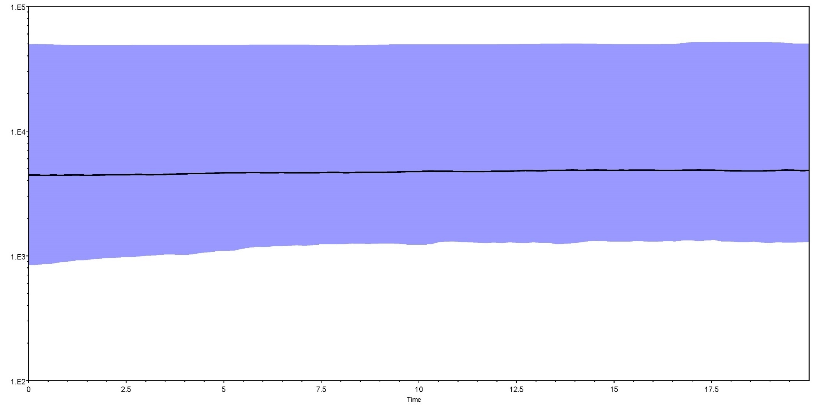
3.2 Results – Population Size
Effective Population Size of RVA against Time
Effective Population Size
median
Introduction of
Rotarix and RotaTeq (2005)
Years before 2015

Slide 20
3.2 Results – Population Size
No observable change in effective population size of RVA
Previous study on a single strain of RVA also showed no change in population size after the introduction of modern vaccines¹.

Slide 21
Conclusions
Between species, RVB has higher positive selection and mutation rate estimates than RVA and RVC. As RVB is currently limited to Asia while RVA and RVC can be found worldwide, the higher estimates may be a reflection of ongoing niche expansion.
Between proteins, the structural proteins have lower positive selection estimates than non-structural proteins. Proteins with core functions, such NSP2 NTPase/helicase, also tend to have lower positive selection and mutation rate estimates than those involved in host invasion, such as NSP4 enterotoxin.
After the introduction of vaccines, new positively selected sites have appeared on RVA’s VP4. However, there seems to be no change in its effective population size.

Slide 22
Acknowledgements
Department Of Veterinary Medicine
Dr Simon Frost
Dr Bethany Dearlove
Mr Mukarram Hossain
Department of Genetics

